Slide 1


St. MARTIN’S ENGINEERING COLLEGE
UGC Autonomous
NBA & NAAC A+ ACCREDITED
Dhulapally, Secunderabad– 500100
Department of Computer Science and Engineering(AI&ML)
Explainable AI for Intrusive Detection Systems: LIME and SHAP Applicability on Multi layer Perceptron
Batch No: 14
1. G. Tanuja (22K81A66C6)
2. Y. Sanjana (22K81A66B8)
3. D. Rishivardhan (22K81A6679)
Under the Guidance of
Mrs. K. Sankeerthana
Assisstant Professor
Department of Computer Science and Engineering(AI&ML)

Slide 2
OUTLINE
Abstract
Introduction
Literature Survey
Existing System
Proposed System
Flow diagram
Algorithms and Techniques
30 % code implementation
References

Slide 3
ABSTRACT
This study presents an explainable AI framework for Intrusion Detection Systems (IDS) using LIME and SHAP to interpret predictions made by deep learning models. IDS are crucial for identifying malicious activity in network traffic, but models like Multi-Layer Perceptrons (MLPs), LSTMs, and TCNs often lack transparency. Using the CIC IDS dataset, the system trains these models and enhances performance with XGBoost and a Hybrid Voting Classifier, achieving up to 100% accuracy. To address the black-box nature of these models, LIME and SHAP are applied for interpretability. SHAP offers both global and local feature importance using game-theoretic principles, while LIME provides localized explanations by perturbing input features. These insights help analysts understand which features influence predictions and why certain instances are flagged as threats. The combination of high accuracy and interpretability improves trust, supports compliance, and enables better decision-making, making the system a robust solution for real-world cybersecurity applications.

Slide 4
INTRODUCTION
Intrusion Detection Systems (IDS) are vital for identifying malicious activity in network traffic and protecting digital infrastructure. While deep learning models like Multi-Layer Perceptrons (MLPs), LSTMs, and TCNs offer high accuracy, their lack of transparency limits trust and interpretability.
This study introduces an Explainable AI (XAI) framework using LIME and SHAP to interpret IDS predictions. Trained on the CIC IDS dataset, the system includes high-performing models enhanced by XGBoost and a Hybrid Voting Classifier, achieving up to 100% accuracy.
SHAP provides both global and local feature importance using game-theoretic principles, while LIME offers instance-level explanations by perturbing input features. These techniques help analysts understand which features influence predictions and why certain instances are flagged as threats.

Slide 5
INTRODUCTION
By combining predictive performance with interpretability, the framework improves decision-making, supports compliance, and fosters trust in AI-driven cybersecurity solutions.
This dual approach makes the IDS both effective and transparent for real-world deployment.

Slide 6
LITERATURE SURVEY
S.NO | AUTHOR | TITLE | YEAR | CONTRIBUTIONS
1 | Patel et al. | LIME-based Interpretability for IDS | 2024 | Used LIME to analyze false positives; improved debugging & reliability
2 | Kumar & Singh | Explainable IDS using MLP and SHAP | 2023 | Used SHAP to interpret MLP outputs; improved IDS clarity & trust.
3 | Khan et al. | Interpretable Intrusion Detection Using Explainable AI | 2022 | Compared LIME, SHAP; SHAP gave stable insights for MLP.
4 | Shapourifard et al. | Explainable Deep Intrusion Detection Using SHAP and LIME | 2021 | Applied LIME & SHAP to deep IDS; enhanced transparency.

Slide 7
EXISTING SYSTEM
The existing IDS frameworks typically use machine or deep learning models such as MLP, Random Forests, or CNNs for classifying network traffic as normal or attack. These models are evaluated purely on accuracy metrics without any introspection into the features contributing to their decisions. As a result, the system lacks explainability and offers no insights into model trustworthiness or decision validation.
Disadvantages:
No support for explainability; operates as a black box.
Limited to single model evaluation without enhancement options.
Lacks interpretability to identify most influential features in predictions.

Slide 8
PROPOSED SYSTEM
The proposed system integrates explainable AI into IDS using LIME and SHAP techniques applied on top of a deep learning MLP model, and further enhanced with models like LSTM, TCN, XGBoost, and Voting Classifier. The system not only predicts attacks with high accuracy but also provides clear justifications for each prediction, allowing better transparency, debugging, and security audits.
Advantages:
Integrates SHAP and LIME for local and global model interpretation.
Experiments with multiple algorithms and ensemble models for optimal accuracy.
Identifies and visualizes key contributing features, enhancing model trust.

Slide 9
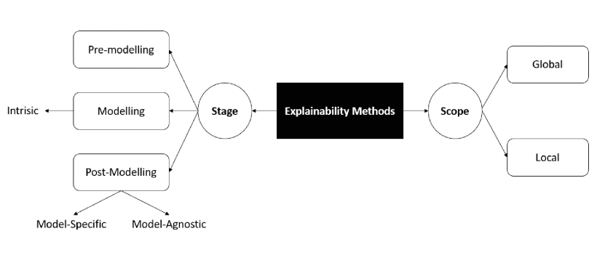
FLOW DIAGRAM

Slide 10
ALGORITHMS
K-Nearest Neighbors (K-NN) – Identifies intrusions by comparing traffic with nearest known patterns.
XGBoost – Uses gradient-boosted trees to efficiently detect complex attack patterns.
Artificial Neural Network (ANN) – Learns nonlinear intrusion patterns through layered neurons.
LSTM – Detects sequential attacks by modeling temporal dependencies in network traffic.
Decision Tree – Classifies network traffic using hierarchical rule-based decisions.

Slide 11
TECHNIQUES
LIME – Explains individual intrusion predictions using a local interpretable surrogate model.
KernelSHAP – Estimates feature contributions for any IDS model using Shapley values.
TreeSHAP – Efficiently computes exact feature importance for tree-based IDS models.
DeepSHAP – Explains neural-network-based IDS using backpropagated Shapley values.
LinearSHAP – Provides exact explanations for linear intrusion detection models.

Slide 12
CODE(30% IMPLEMENTATION)
#Train IDS model
from sklearn.ensemble import RandomForestClassifier
model = RandomForestClassifier(n_estimators=100, random_state=42)
model.fit(X_train, y_train)
# Predict
y_pred = model.predict(X_test)
from lime.lime_tabular import LimeTabularExplainer
lime_explainer = LimeTabularExplainer(
X_train,
feature_names=feature_names,
class_names=["Normal", "Attack"],
mode="classification"

Slide 13
exp = lime_explainer.explain_instance(
X_test[0],
model.predict_proba,
num_features=5
)
exp.show_in_notebook()
import shap
shap_explainer = shap.TreeExplainer(model)
shap_values = shap_explainer.shap_values(X_test)
# Global explanation
shap.summary_plot(shap_values[1], X_test, feature_names=feature_names)
# Local explanation
shap.force_plot(
shap_explainer.expected_value[1],
shap_values[1][0],
X_test[0],
feature_names=feature_names,
matplotlib=True
)

Slide 14
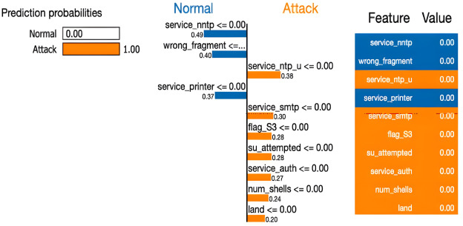
EXPECTED OUTCOME

Slide 15
REFERENCES
[1]. L. Santos, C. Rabadao, and R. Gonçalves, “Intrusion detection systems in Internet of Things: A literature review,” in Proc. 13th Iberian Conf. Inf. Syst. Technol. (CISTI), Caceres, Spain, Jun. 2018.
[2]. M. Conti, A. Dehghantanha, K. Franke, and S. Watson, “Internet of Things security and forensics: Challenges and opportunities,” Future Gener. Comput. Syst., vol. 78, pp. 544–546, Jan. 2018.
[3]. D. Gunning and D. W. Aha, “DARPA’s explainable artificial intelligence program,” AI Mag., vol. 40, no. 2, pp. 44–58, 2019.
[4]. M. Wang, K. Zheng, Y. Yang, and X. Wang, “An explainable machine learning framework for intrusion detection systems,” IEEE Access, vol. 8, pp. 73127–73141, 2020.
[5]. S. Mane and D. Rao, “Explaining network intrusion detection system using explainable AI framework,” 2021.

Slide 16
REFERENCES
[6]. S. Patil, V. Varadarajan, S. M. Mazhar, A. Sahibzada, N. Ahmed, O. Sinha, S. Kumar, K. Shaw, and K. Kotecha, “Explainable artificial intelligence for intrusion detection system,” Electronics, vol. 11, no. 19, p. 3079, 2022.
[7]. D. L. Marino, C. S. Wickramasinghe, and M. Manic, “An adversarial approach for explainable AI in intrusion detection systems,” in Proc. IECON 44th Annu. Conf. IEEE Ind. Electron. Soc., 2018.
[8]. M. Siganos, P. Radoglou-Grammatikis, I. Kotsiuba, E. Markakis, I. Moscholios, S. Goudos, and P. Sarigiannidis, “Explainable AI-based intrusion detection in the Internet of Things,” in Proc. 18th Int. Conf. Availability, Rel. Secur. New York, NY, USA : Association for Computing Machinery, Aug. 2023.
[9]. P. Barnard, N. Marchetti, and L. A. DaSilva, “Robust network intrusion detection through explainable artificial intelligence (XAI),” IEEE Netw. Lett., vol. 4, no. 3, pp. 167–171, Sep. 2022.
[10]. B. Sharma, L. Sharma, C. Lal, and S. Roy, “Explainable artificial intelligence for intrusion detection in IoT networks: A deep learning based approach,” Exp. Syst. Appl., vol. 238, Mar. 2024

Slide 17
REFERENCES
[11]. S. Neupane, J. Ables, W. Anderson, S. Mittal, S. Rahimi, I. Banicescu, and M. Seale, “Explainable intrusion detection systems (X-IDS): A survey of current methods, challenges, and opportunities,” IEEE Access, vol. 10, 2022.
[12]. M. T. Ribeiro, S. Singh, and C. Guestrin, “Anchors: High-precision model-agnostic explanations,” in Proc. AAAI Conf. Artif. Intell., vol. 32, no. 1, 2018.
[13]. D. W. Apley and J. Zhu, “Visualizing the effects of predictor variables in black box supervised learning models,” J. Roy. Stat. Soc. Ser. B, Stat. Methodol., vol. 82, no. 4, pp. 1059–1086, 2020.
[14]. S. Lundberg and S.-I. Lee, “A unified approach to interpreting model predictions,” 2017.
[15]. M. T. Ribeiro, S. Singh, and C. Guestrin, “Why should i trust you?’ Explaining the predictions of any classifier,” in Proc. 22nd ACM SIGKDD Int. Conf. Knowl. Discovery Data Mining, 2016.

Slide 18
QUERIES ??

Slide 19
THANK YOU

